Slide 1

Parameter Estimation & Residual Analysis
Dr. Abolfazl Saghafi
Assistant Professor of Statistics & Data Science
Notes:
We continue this week by estimating Autoregressive and Moving Average time series parameters, then follow up with residual analysis

Slide 2
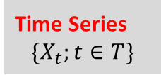
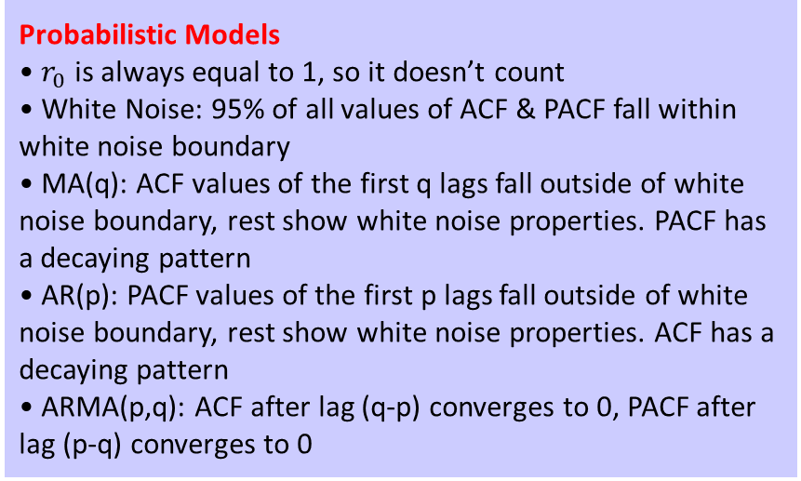
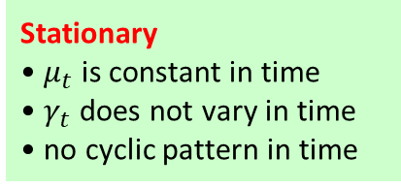
Probabilistic Models
• $r_{0}$ is always equal to 1, so it doesn’t count
• White Noise: 95% of all values of ACF & PACF fall within white noise boundary
• MA(q): ACF values of the first q lags fall outside of white noise boundary, rest show white noise properties. PACF has a decaying pattern
• AR(p): PACF values of the first p lags fall outside of white noise boundary, rest show white noise properties. ACF has a decaying pattern
• ARMA(p,q): ACF after lag (q-p) converges to 0, PACF after lag (p-q) converges to 0
ACF
Stationary
• $μ_{t}$ is constant in time
• $γ_{t}$ does not vary in time
• no cyclic pattern in time
PACF
Time Series
$$\{X_{t};t∈T\}$$
Variation Change
• Box-Cox Transformation
Trend
• Regression
• Moving Average
• Differencing
Other
• ARIMA(p,d,q): Differencing that removes trend and seasonality, generates stationary ARMA(p,q)
• ARFIMA(p,d,q): Non-integer differencing. For 0<d<0.5, they are Stationary.
Non-Stationary
Seasonality
• Averaging
• Regression
• Lagged-Differencing
Notes:
An overview of what we discussed so far
IMPORTANT:

Slide 3
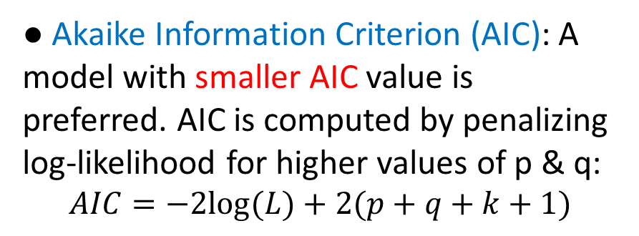
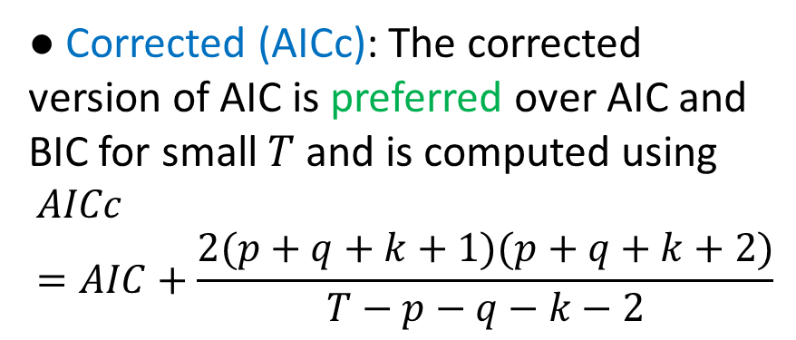
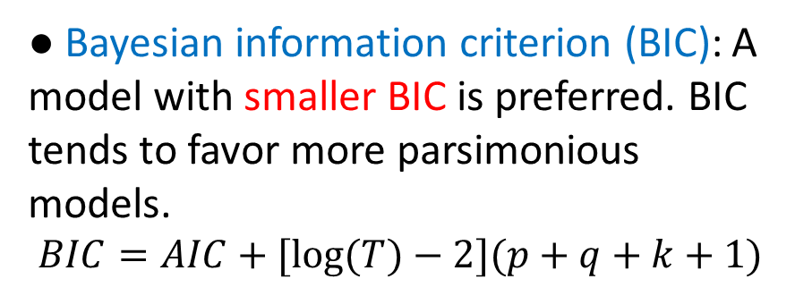
Goodness of Fit Measures
● Akaike Information Criterion (AIC): A model with smaller AIC value is preferred. AIC is computed by penalizing log-likelihood for higher values of p & q:
$$AIC=−2log⁡(L)+2(p+q+k+1)$$
The main measure of time series model fit is log-likelihood. That is, the logarithm of the probability of the observed data coming from the estimated model.
● Bayesian information criterion (BIC): A model with smaller BIC is preferred. BIC tends to favor more parsimonious models.
$$BIC=AIC+[log⁡(T)−2](p+q+k+1)$$
The smaller the values of log-likelihood, the better the model. However, models selected solely based on log-likelihood are prone to overfitting.
● Corrected (AICc): The corrected version of AIC is preferred over AIC and BIC for small $T$ and is computed using
$$AICc=AIC+\frac{2(p+q+k+1)(p+q+k+2)}{T−p−q−k−2}$$
There are methods to estimate order of differencing, if required, to achieve stationarity. See end of week 2 material.
Notes:
It is important to note that these information criteria tend NOT to be good guides to selecting the appropriate order of differencing (d) of a model, but only for selecting the values of p and q. This is because the differencing changes the data on which the likelihood is computed, making the AIC values between models with different orders of differencing not comparable. So we need to use some other approach to choose d, and then we can use the AICc to select p and q.
In these formula, k is equal to 1 if model fit include an intercept and 0 otherwise. The intercept is the which the time series fluctuates around, it is estimated by average of all the time series values.

Slide 4
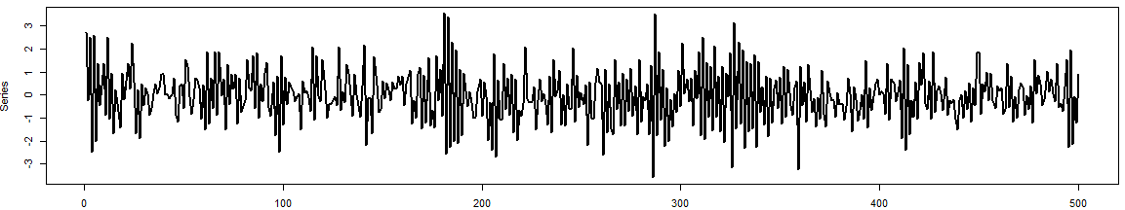
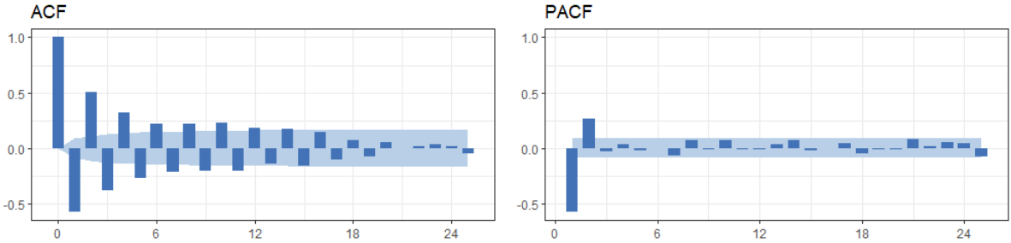
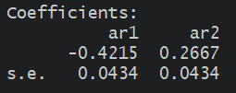



Example 1
Identify the type and order of the given time series and estimate its parameters.
❶ The time plot shows a stationary time series.
❷ The ACF/PACF plots suggest an AR(2) model.
❸ Parameter estimations shows
$$X_{t}=−0. 42X_{t−1}+0.27 X_{t−2}+ε_{t}$$
● What we used for simulations
$$X_{t}=−0. 4X_{t−1}+0.3 X_{t−2}+ε_{t}$$

Slide 5
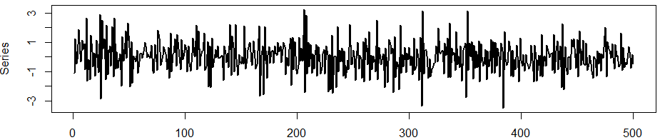
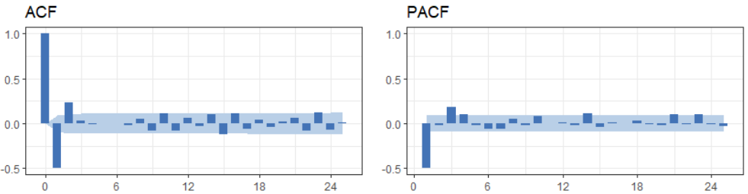



Example 2
Identify the type and order of the given time series and estimate its parameters.
❶ The time plot shows a stationary time series.
❷ The ACF/PACF plots suggest an MA(2) model.
❸ Parameter estimations shows
$$X_{t}=ε_{t}−0. 53ε_{t−1}+0.37ε_{t−2}$$
● What we used for simulations
$$X_{t}=ε_{t}−0. 5ε_{t−1}+0.4ε_{t−2}$$
Notes:
If you are in doubt about the order and type of model, you can fit different models and compare their goodness of fit measures. I have done that in the lab session so be sure to check it out.

Slide 6
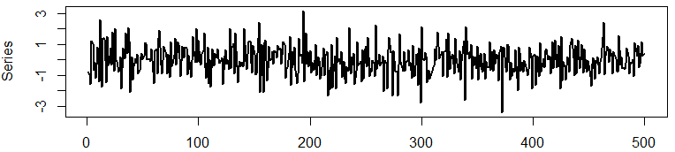
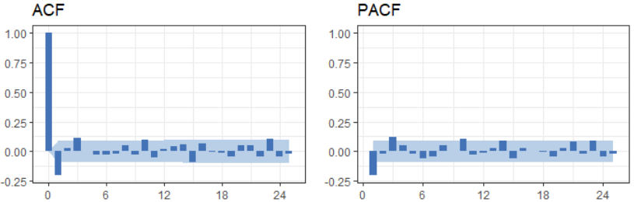
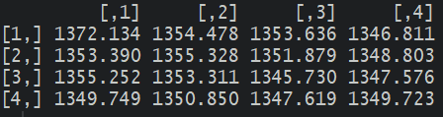

Example 3
Identify the type and order of the given time series and estimate its parameters.
❶ The time plot shows a stationary time series.
❷ Using ACF/PACF plots, it is hard to determine a suitable ARMA(p,q) model.
❸ AIC values suggests an ARMA(2,2)
● What we used
$$X_{t}=0.4 X_{t−1}−0.3 X_{t−2}+ε_{t}−0.6ε_{t−1}+0.5ε_{t−2}$$

Slide 7
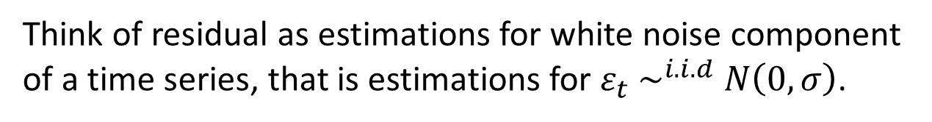
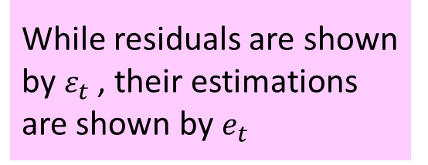
Residual Analysis
Residual Assumptions
• Random values
When a model has been ﬁtted to a time series, it is advisable to check that the model really does provide an adequate description of the data. This is usually done by looking at the residuals
Residual = Observation – Fitted Value
• Zero Mean
• Constant Variance
• Normal Distribution
While residuals are shown by $ε_{t}$, their estimations are shown by $e_{t}$
Think of residual as estimations for white noise component of a time series, that is estimations for $ε_{t} \sim ^{i.i.d} N\left(0, σ\right)$.
For a univariate time-series model, the ﬁtted value is the one-step-ahead forecast and is automatically generated when fitting a ARMA model.

Slide 8
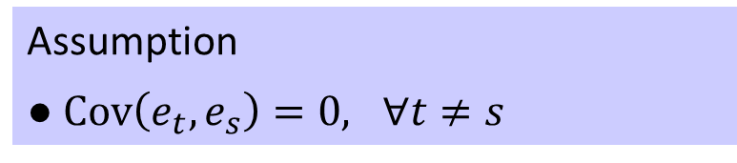
Randomness
Assumption
● $Cov\left(e_{t},e_{s}\right)=0, ∀t≠s$
Visual inspection of time plot of residuals and their ACF/PACF should demonstrate white noise properties.
Diagnosis
● Residual plot should show random fluctuations
● ACF/PACF plots should show white noise characteristics
● Bartels rank test of randomness should not be significant
Randomness tests should be insignificant.
Notes:
One of the model assumptions that we had was independence of errors.
Portmanteau test looks at the ﬁrst K values of the residual correlogram all at once.

Slide 9

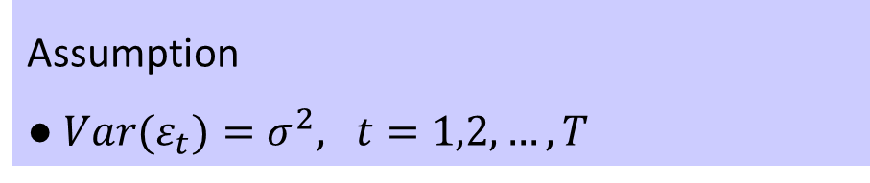
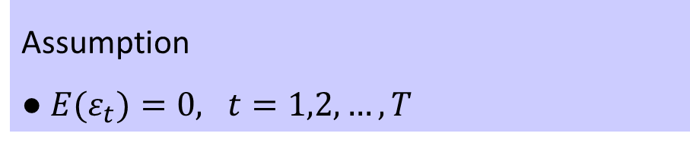
Constant Variance & Zero Mean
Assumption
● ${Var(ε}_{t})=σ^{2}, t=1,2,…,T$
Diagnosis
● The variability of residuals in time plot should be constant
● Breusch-Pagan test should not be significant
Satisfactory time plot of residuals should give the following overall impression:
Assumption
● ${E(ε}_{t})=0, t=1,2,…,T$
In a satisfactory time plot of residuals, observations should fluctuate around zero:
0
Diagnosis
● Residuals should fluctuate around zero
● One-sample t-test should not be significant
Notes:
If the one-sample t-test should is significant, then you will need to fit an ARMA model that includes the intercept, that’s IF the time series is stationary.

Slide 10
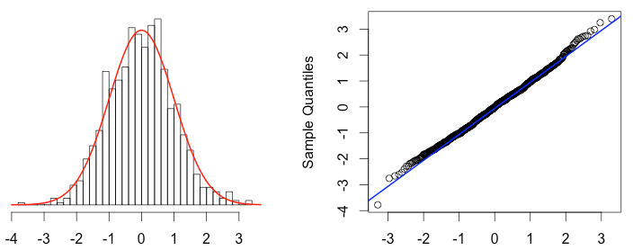
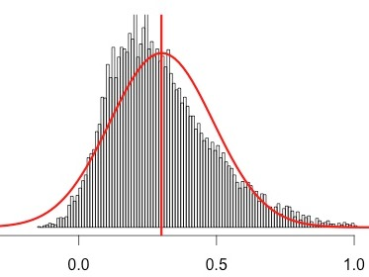
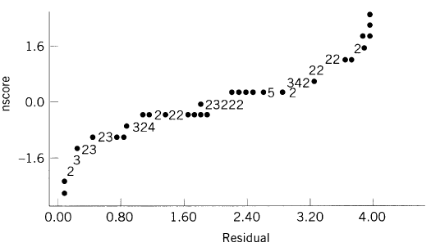
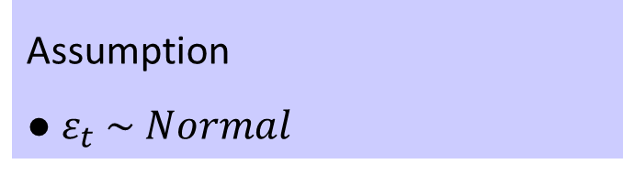
Normal Distribution
Assumption
● $ε_{t} \sim Normal$
Normal pattern:
Diagnosis
● Histogram of residuals
● Normal PP or QQ plot
● Normality tests such as Kolmogorov-Smirnov (under 100 values) and Shapiro-Wilk
Not Normal:
Notes:
The final assumption is normality of errors. Inference is fairly robust to nonnormality however prediction intervals are unreliable if this assumption is violated.
Often a simple histogram, or a stem and leaf plot, will be enough to check this assumption. Normal PP or QQ plots are also a good tool to check this assumption. A normal distribution creates a PP or QQ plot in which points are spread along a line with little variation. If the dots do deviates a lot from a line then normality is not met.
There are also statistical tests that check normality. Tests such as Kolmogorov-Smirnov and Shapiro-Wilk.

Slide 11
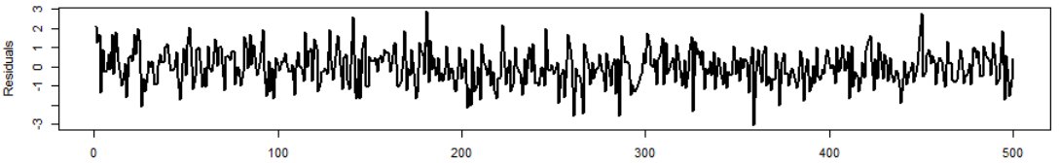
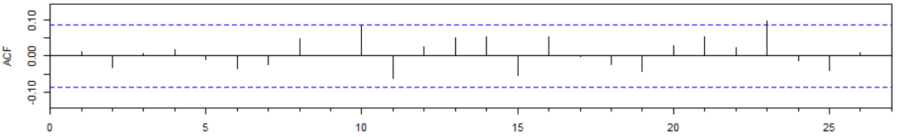
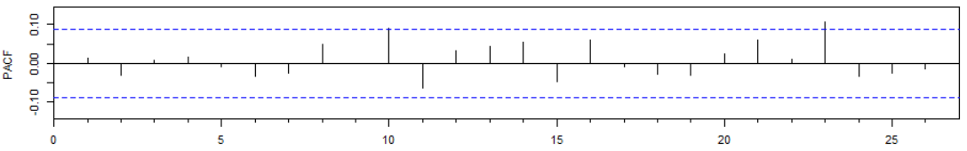
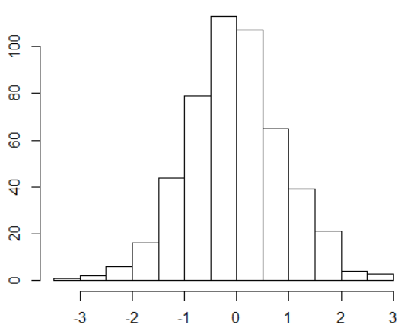
Example 1
We fitted an AR(2) to a simulated time series. We now investigate residuals.
Residual Plot shows random fluctuations, around zero, spreading in a fixed bound.
ACF/PACF demonstrate white noise properties.
Histogram shows normal distribution.
Notes:
Follow the R session to see the tests to verify the assumptions

Slide 12
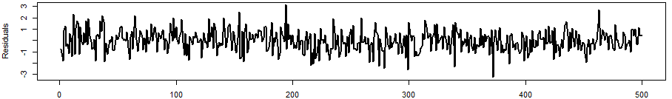
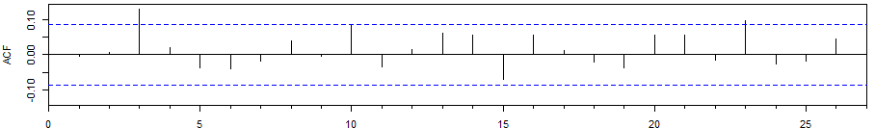
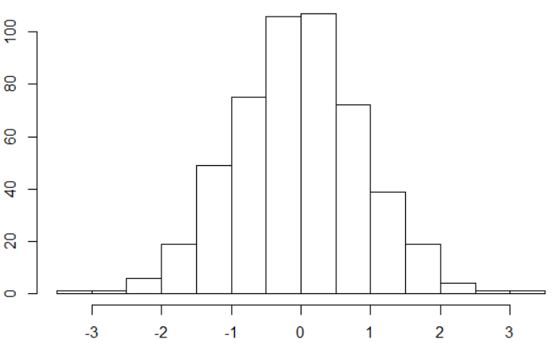
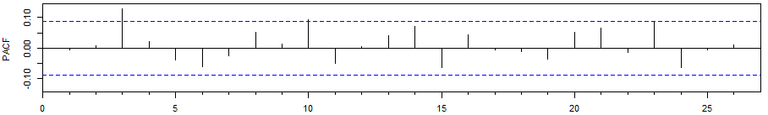
Example 3
The best fit was an ARMA(2,2) but what if we fit AR(1)?
Residual Plot shows random fluctuations, around zero, spreading in a fixed bound. ACF/PACF shows a warning sign of model inadequacy. Histogram shows normal distribution.
Although tests confirm model assumptions BUT the ACF/PACF plot give out warnings.
The warnings might not happen with all inadequate models. If you fit MA(3) for example, everything checks out. However, MA(3) has higher AIC/BIC values than ARMA(2,2).
Notes:
In the end, keep in mind that as George Box, one of the great statistical minds of the 20th century describes, “All models are wrong, but some are useful”.

Slide 13
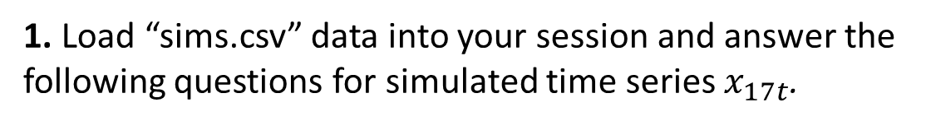
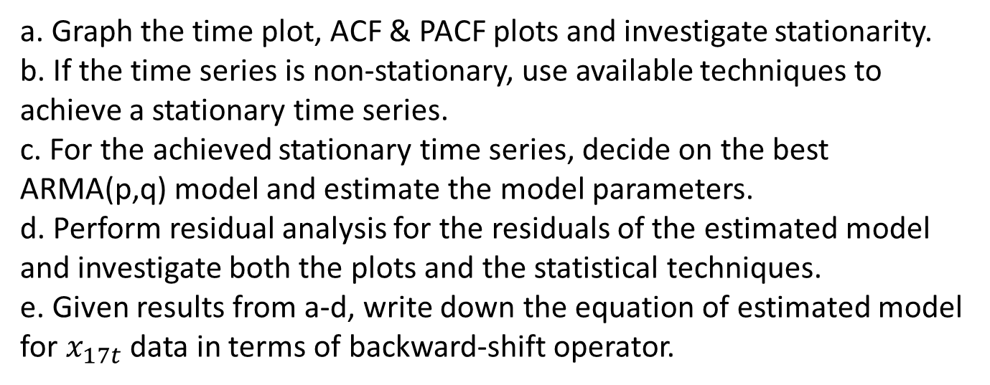
Practice Problems
1. Load “sims.csv” data into your session and answer the following questions for simulated time series $x_{17t}$.
a. Graph the time plot, ACF & PACF plots and investigate stationarity.
b. If the time series is non-stationary, use available techniques to achieve a stationary time series.
c. For the achieved stationary time series, decide on the best ARMA(p,q) model and estimate the model parameters.
d. Perform residual analysis for the residuals of the estimated model and investigate both the plots and the statistical techniques.
e. Given results from a-d, write down the equation of estimated model for $x_{17t}$ data in terms of backward-shift operator.
2. Repeat the same steps for $x_{18t}$and $x_{19t}$ in “sims.csv” dataset.

